Slide 1
A Seminar on DFFMD-A DEEPFAKE FACE MASK DATASET FOR INFECTIOUS DISEASE ERA WITH DEEPFAKE DETECTION ALGORITHMS
Team Details
Team No-1
1. Ch.Sweekruthi Reshma (21EG505810)
2. L.Sreepadh (21EG505845)
3. T.Meghanath (21EG505865)
Project Supervisor
Mrs.B.Ujwala
Assistant Professor

Slide 2
Introduction
The recent growth of technology in computer-generated editing programs has made synthesizing and modifying media content easier than ever. The potential for misinformation spread has exploded, especially with the phenomenon known as Deepfake. Deepfake is a technology that uses deep learning to create fake videos, alter existing videos, or even synthesize the speech of someone’s voice. This makes it a dangerous tool in malicious applications of spreading fake news and disseminating false or dangerous information. Therefore, developing digital forensic deep learning models and algorithms to detect fakes is more critical for digital security than ever.

Slide 3
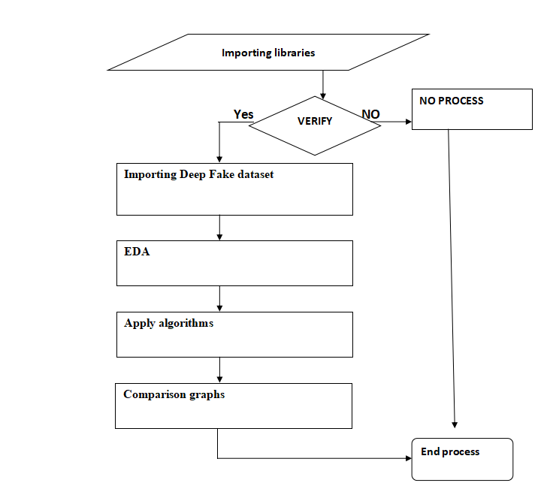
Concept Tree
Exploratory Data Analysis

Slide 4
Literature
Author(s) | Method | Advantages | Disadvantages
Firas Husham,Almukhtar (2022) | Convolutional Neural Networks (CNN) and Long Short-Term Memory (LSTM). | 1. Comprehensive approach to detect deep fake content. 2. Leveraging advanced AI techniques like CNN and LSTM. | 1. Lack of technical details on AI programming and methodology. 2. Absence of discussions on practical challenges and limitations.
SaadaldeenRashidAhmed; EmrullahSonuç; Mohammed Rashid Ahmed; Adil Deniz Duru (2022) | Convolutional Neural Networks (CNN) | 1.Addresses critical privacy and security concerns related to Deepfake Technology 2. Offers a historical overview and insights into deepfake techniques | 1. Lacks specific technical details about proposed detection methods. 2. May not cover the latest advancements in deepfake technology and detection

Slide 5
Literature
Author(s) | Method | Advantages | Disadvantages
S. Bommareddy, Tanya Samyal , S. Dahiya (2023) | Convolutional Neural Networks (CNN) and V4D architecture. | 1. 1. The use of the V4D architecture suggests a comprehensive approach to analyzing manipulated videos, encompassing various manipulation techniques 2. The study aims to identify DeepFake videos in three different contexts, including all types of manipulations, single manipulations, and cross-manipulation detection, providing a nuanced understanding of authenticity. | 1. The mention of the V4D architecture without detailed information makes it challenging to assess its complexity, potential limitations, and ease of implementation. 2.The creation of algorithms for classifying manipulation methods may introduce challenges related to false positives, false negatives, and the adaptability of the algorithms to emerging manipulation techniques.

Slide 6
Literature
Author(s) | Method | Advantages | Disadvantages
J. Hu, X. Liao, W. Wang and Z. Qin (2022) | A two-stream approach for identifying compressed deepfake videos by analyzing frame-level and temporality_x0002_level features | 1.Incorporates temporality-level analysis for extracting temporal consistency features. 2.Demonstrates superior performance compared to existing methods. | 1. The paper does not elaborate on the technical details of the proposed two- stream method. 2. Lack of discussion on potential limitations or challenges in real-world applications.
Coccomini, D.A., Messina, N., Gennaro, C., Falchi (2022) | Vision Transformers and an EfficientNet B0 | 1.Effective combination of Vision Transformers and EfficientNet B0 for accurate deepfake detection. 2.Competitive results without the need for distillation or ensemble methods. | 1. The paper lacks detailed information about the technical aspects of the proposed method. 2. Potential challenges and limitations in real- world scenarios are not discussed.

Slide 7
Problem Statement
The rise of deepfake technology poses a significant threat to various aspects of society, enabling the creation of fake images and videos with synthesized or replaced faces. This phenomenon has become more pronounced and challenging due to the widespread use of face masks, particularly since the onset of the infectious disease outbreak in 2020.
Face masks obstruct defining facial features, making it increasingly difficult to identify and distinguish between authentic and synthetic content. This situation raises concerns about the potential malicious use of deepfakes
Existing Method Disadvantages:
1.The two-stream DNN method is too complicated with large training time.
2.The Convolutional Vision Transformer has high false positives.
3.They did not perform preprocessing stages,like residual connection, and batch normalization and data augmentation. So, it may leads to decrease in performance.

Slide 8
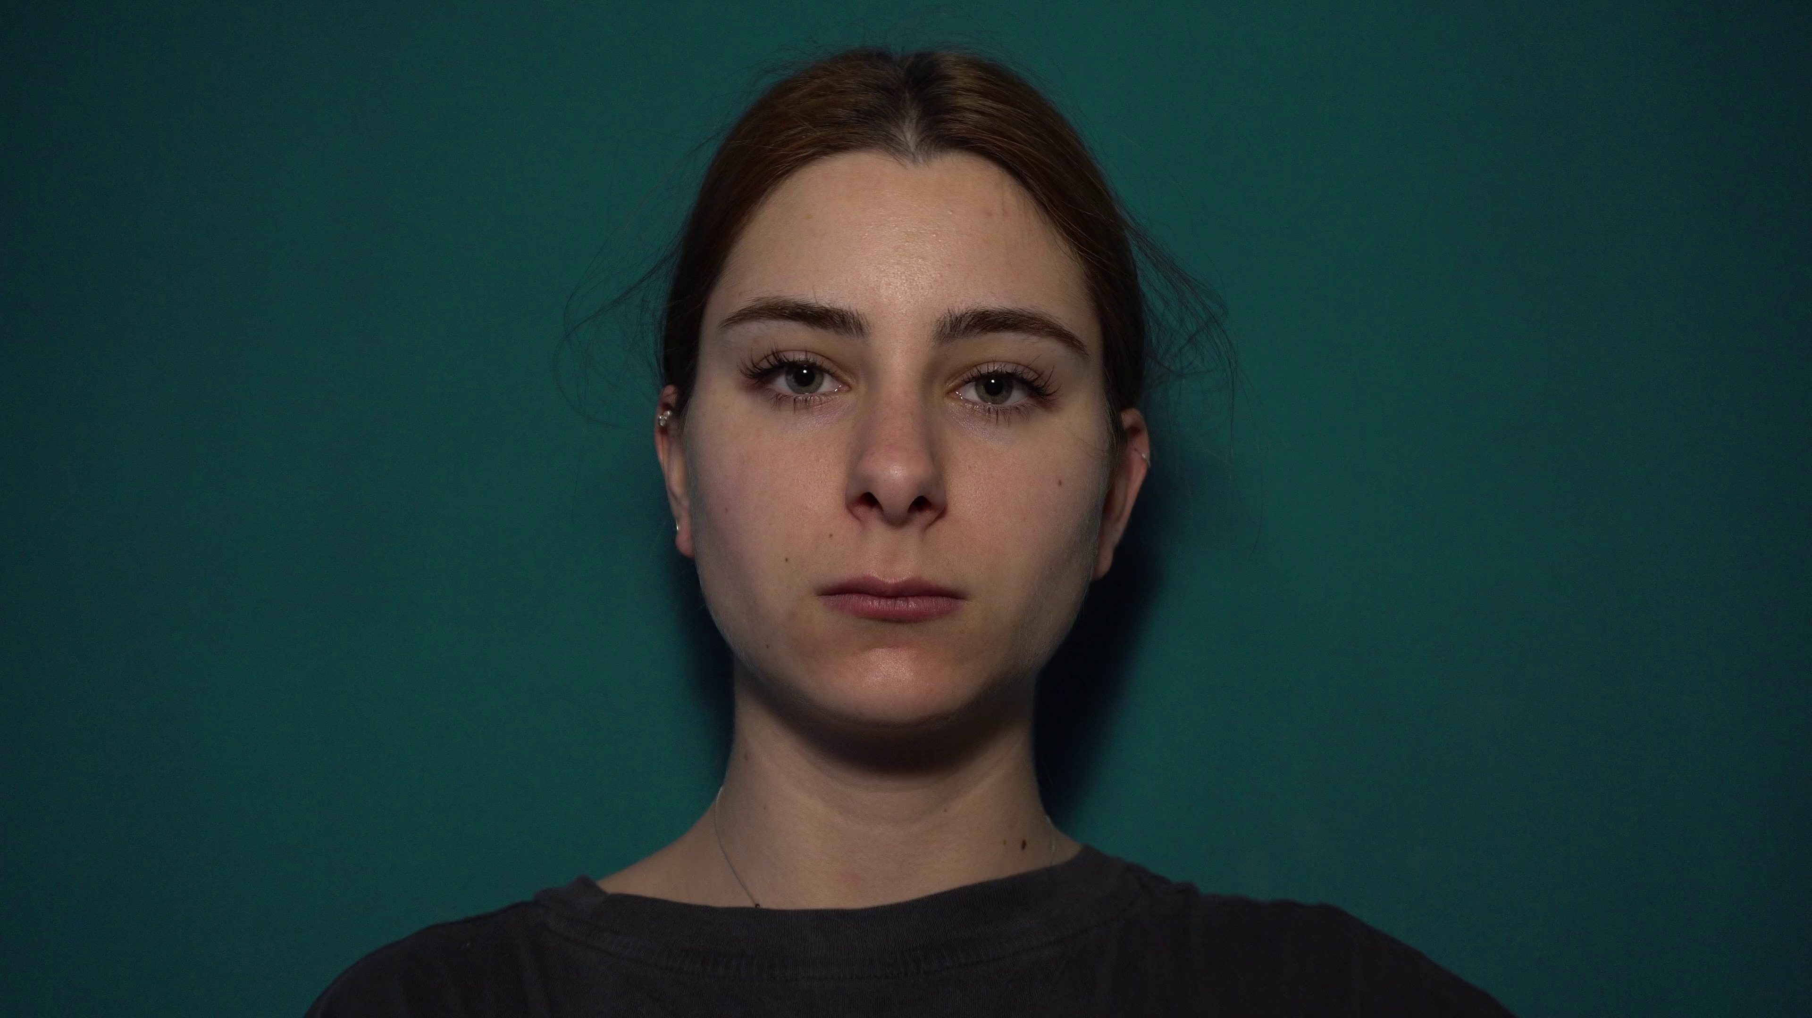
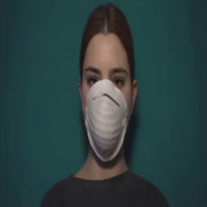
Problem Illustration
REAL
FAKE

Slide 9
Proposed Method
The proposed system tackles the escalating societal concern of deepfakes through innovative methodologies. Introducing the Deepfake Face Mask Dataset (DFFMD) and leveraging a novel Inception-ResNet-v2 approach, augmented with preprocessing stages, feature-based analysis, residual connections, and batch normalization, the research significantly enhances the accuracy of deepfake video detection amidst face masks—filling a critical gap left by conventional methods.
The investigation delves into various deep learning models, including VGG19, CNN, and an extended Xception architecture, showcasing a comprehensive exploration of techniques for combating deepfake threats. This multifaceted approach establishes a robust foundation for advanced deepfake detection, crucial in mitigating the adverse impacts of falsified content in an era dominated by evolving digital challenges.

Slide 10
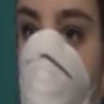
Proposed Method Illustration
When we upload the video the video will break down in to different angle of frames and those each frame is processed by the model and will predict whether the video is Real or Fake.

Slide 11
Parameter
Parameters Considering :
Accuracy = True positive(TP) + True Negative(TN)/ (True positive(TP) + True negative(TN) + False positive(FP) + False negative(FN))
Recall = True Positive (TP) / True Positive (TP) + False Negative (FN)
Precision = True positive(TP)/ (True positive(TP) + False positive(FP))
F1 Score = 2*precision*recall/ precision+recall
Specificity = True Negative(TN) / False Positive(FP) + True Negative(TN)
Sensitivity = True Positive(TP)/False Negative(FN)+True Positive(TP)

Slide 12
Experiment Environment
Tools:
Anaconda
Sqlite
Jupyter Notebook
Language:
Python
Dataset:
The dataset is collected from kaggle which is the first dataset with a face mask in the field of DeepFake. We can use the dataset to predict whether the video of a person wearing a face mask is a deepfake or not.

Slide 13
Project Status
S.No | Functionality | Status (Completed /in-progress/Not started)
01 | Research Paper Collection | Completed
02 | Dataset Collection | Completed
03 | Code Implementation: Training Testing | In-Progress
04 | Documentation | Not Started
Note: Submit Form 1,2 and 3

Slide 14
References
[1] Almukhtar, F.H. (2022). A robust facemask forgery detection system in video. Periodicals of Engineering and Natural Sciences (PEN).
[2] S. R. Ahmed, E. Sonuç, M. R. Ahmed and A. D. Duru, "Analysis Survey on Deepfake detection and Recognition with Convolutional Neural Networks," 2022 International Congress on Human-Computer Interaction, Optimization and Robotic Applications (HORA), Ankara, Turkey, 2022, pp. 1-7, doi: 10.1109/HORA55278.2022.9799858.
[3] S. Bommareddy, T. Samyal and S. Dahiya, "Implementation of a Deepfake Detection System using Convolutional Neural Networks and Adversarial Training," 2023 3rd International Conference on Intelligent Technologies (CONIT), Hubli, India, 2023, pp. 1-6, doi:
10.1109/CONIT59222.2023.10205614.
[4] J. Hu, X. Liao, W. Wang and Z. Qin, "Detecting Compressed Deepfake Videos in Social Networks Using Frame-Temporality Two-Stream Convolutional Network," in IEEE Transactions on Circuits and Systems for Video Technology, vol. 32, no. 3, pp. 1089-1102, March 2022, doi:10.1109/TCSVT.2021.3074259.
[5]Coccomini, D.A., Messina, N., Gennaro, C., Falchi, F. (2022). Combining EfficientNet and Vision Transformers for Video Deepfake Detection. In: Sclaroff, S., Distante, C., Leo, M., Farinella, G.M., Tombari, F. (eds) Image Analysis and Processing – ICIAP 2022. ICIAP 2022. Lecture Notes in Computer Science, vol 13233. Springer, Cham. https://doi.org/10.1007/978-3- 031-06433-3_19

Slide 15
Thank You

